Slide 1
SENTIMENT ANALYSIS
CAPSTONE PROJECT
Presented By:
AYINAPARTHI.YASWANTH.
ADITYA COLLEGE OF ENGINEERING
ELECTRONICS AND COMMMUNICATION ENGINEERING

Slide 2
OUTLINE
Problem Statement (Should not include solution)
Proposed System/Solution
System Development Approach (Technology Used)
Algorithm & Deployment
Result
Conclusion
Future Scope
References

Slide 3
Problem Statement
Example:Develop a sentiment analysis model to classify reviews as positive or negative. And pre-process the review text using techniques such as lower casing, removing stop words and lematization. Use the trained model accurately predict the sentiment new ,unseen reviews.

Slide 4
Proposed Solution
To propose a solution for sentiment analysis, we'll outline a systematic approach that integrates data collection, pre-processing, machine learning, and deployment. Here’s a step-by-step guide::
Data Collection:
Collecting data for sentiment analysis involves gathering textual data that contains opinions, emotions, or sentiments expressed by individuals.
Determine where you will collect data from (e.g., social media platforms, review websites, customer feedback forms).
Data Pre-processing:
Sentiment analysis (also known as opinion mining or emotion AI) is the use of natural language processing, text analysis, computational linguistics, and biometrics to systematically identify, extract, quantify, and study affective states and subjective information.
There are few steps involved in data pre-processing they are Data cleaning,Tokenisation,handling negations and contractions, Removing rare words, encoding sentiment analysis,vectorization,Data normalization. "pandas” and “scikit learn "are commonly used for data pre processing.
Machine Learning Algorithm:
Implement a machine learning algorithm, such as a Naive byas, support vector machines, logistic regression, random forest, Deep learning models like LSTM AND CSTM.
For sentiment analysis, several machine learning algorithms can be effective, depending on the size and nature of your dataset.
Deployment:
Deploying a sentiment analysis system involves setting up infrastructure to make the model accessible for processing text inputs and returning sentiment predictions.
Thera few approaches like Model selection and training, Building the Deployment pipeline, Deployment infrastructure, Monitoring and maintenance, Documentation and support.
Evaluation:
Evaluation of sentiment analysis models is crucial to assess their performance and reliability in classifying sentiments from textual data
There are evaluation approaches such as cross-validation and stratified sampling and also some domain challenges in evaluating ,Data preparation,Model training,evaluation,comparision and fine tuning.
Result : By following steps you can access evaluation for the sentiment analysis

Slide 5
System Approach
The "System Approach" section outlines the overall strategy and methodology for developing and implementing the sentimental analysis. Here's a suggested structure for this section:
System requirements
Windows 10
Jupiter notebook or google colab.
Library required to build the model
‘Pandas’ for Jupiter notebook and Google colab.
‘tweepy‘ for twitter data.

Slide 6
Algorithm & Deployment
In the Algorithm section, describe the machine learning algorithm chosen for predicting sentiment analysis. Here's an example structure for this section:
Algorithm Selection:
Sentiment analysis, also known as opinion mining, utilizes various algorithms to classify the sentiment expressed in textual data.
there are few algorithms used they are Naïve Bayes classifier, Support vector machine, logistics Regression, Deep learning process like LSTM and CNN..
Data Input:
Input data for sentiment analysis typically consists of textual content that contains opinions, emotions, or sentiments expressed by individuals
There are inputs like textual inputs, text representation and character level representation.
Training Process:
The training process for sentiment analysis involves preparing the data, selecting an appropriate algorithm or model, training the model on labelled data, and evaluating its performance.
Prediction Process:
. Train the sentiment analysis model using labelled data and predict sentiment labels for new input text data.
Use the loaded model to predict the sentiment label for the input text.

Slide 7
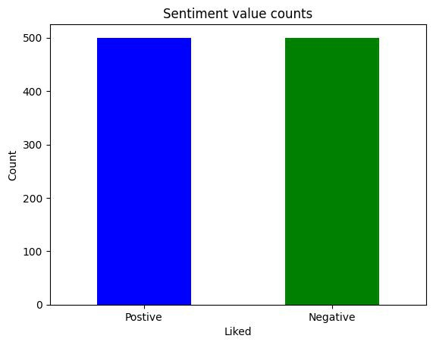
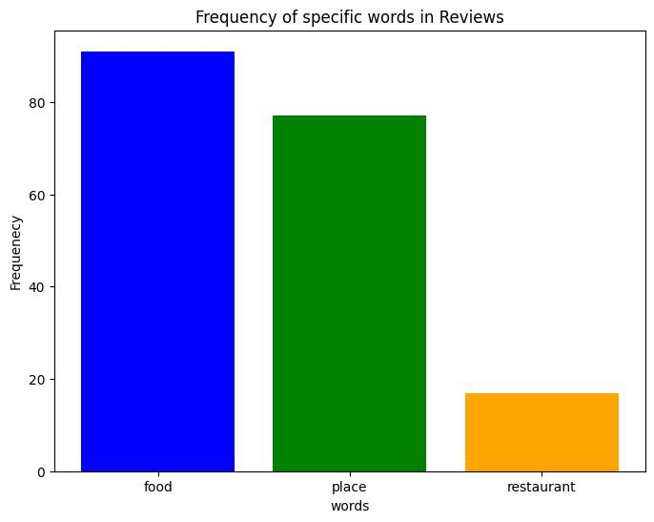
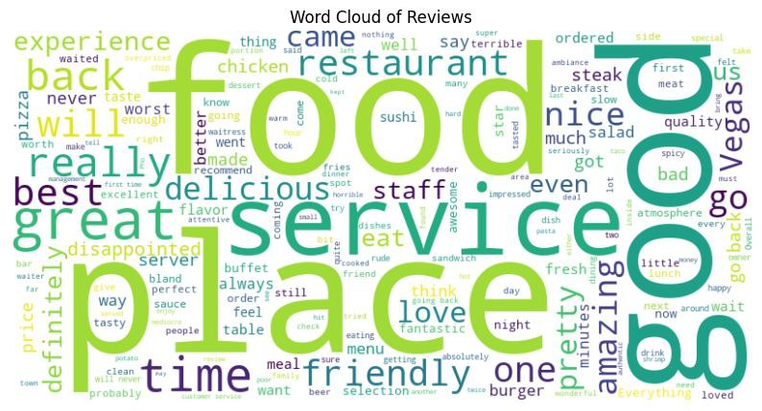
Result
The above are the resultant pie charts of the sentimental analysis.
The first figure represents the number of positive and negative counts and the second pie represents the type of frequency liked which means food place or restaurant..
The proportion of correctly classified instances (both positive and negative sentiments) out of the total number of instances. Which Is also known as the accuracy.

Slide 8
Conclusion
Sentiment analysis project successfully applied Machine learning to analyse sentiment in text analysis .Through the use of algorithms, we acquired 80-85% of accuracy. The analysis revealed in demonstrating the effectiveness of sentiment analysis. However, challenges such as Data and model limitations. highlight areas for improvement. Moving forward, further research could explore potential improvements.
This analysis which helps companies improve their products and services based on genuine and specific customer feedback.

Slide 9
Future scope
The future scope of sentiment analysis holds promising opportunities for advancements and applications across various domains.
The future of sentiment analysis holds tremendous potential for innovation and growth across various domains. Advancements in technology, coupled with expanding data sources and evolving user behaviours, will continue to drive the development of more sophisticated sentiment analysis techniques.

Slide 10
References
"Sentiment Analysis: Sentiments, and Emotions" by Bing Liu - Provides a comprehensive overview of sentiment analysis techniques, algorithms, and applications.
Reddit platform : the subreddit which was used for machine learning and language technology often refers the sentiment analysis.
We used the google colab and the Jupiter notebook for the coding purpose and reddit for research on the topic.

Slide 11
THANK YOU

